Slide 1
We will not sit here and die.
David Miranda
Pastor of West End Church

Slide 2
Setting |
5 Characters The King
The Broken City
The Prophet of God
The Doubting Servant
The Radical Lepers

Slide 3
Setting |
Samaria – Capital of Israel
A fortified city

Slide 4
2 Kings 6
Famine in Besieged Samaria
24 Some time later, Ben-Hadad king of Aram mobilized his entire army and marched up and laid siege to Samaria. 25 There was a great famine in the city; the siege lasted so long that a donkey’s head sold for eighty shekels[a] of silver, and a quarter of a cab[b] of seed pods[c] for five shekels.[d

Slide 5
26-29
²⁶ As the king of Israel was passing by on the wall, a woman cried to him, “Help me, my lord the king!”
²⁷ The king replied, “If the Lord does not help you, where can I get help for you? From the threshing floor? From the winepress?”

Slide 6
²⁸ Then he asked her, “What’s the matter?”
She answered, “This woman said to me, ‘Give up your son so we may eat him today, and tomorrow we’ll eat my son.’ ²⁹ So we cooked my son and ate him. The next day I said to her, ‘Give up your son so we may eat him,’ but she had hidden him.”

Slide 7
30-33
³⁰ When the king heard the woman’s words, he tore his robes. As he went along the wall, the people looked, and they saw that, under his robes, he had sackclothon his body. ³¹ He said, “May God deal with me, be it ever so severely, if the head of Elisha son of Shaphat remains on his shoulders today!”

Slide 8
Progression |
1. Man will trust in his own strength
2. Man will be deceived
3. Will forget his identity
4. He will be empty and without hope and will have no hope for others *
5. He will begin to shift blame

Slide 9
1. Idols Pastors Face – Carey Nieuwhof.
Strategy
Skill
Size
Stats
More

Slide 10
7 Tactics used by the enemy
Cynicism, the past, and Self interest
Compromise – 1000 compromises that lead to 1
Disconnection – leadership is lonely
Irrelevance – God doesn’t change culture and ministry do
Pride
Burnout
Emptiness

Slide 11
Losing our Identity
Somehow we American pastors, without really noticing what was happening, got our vocations redefined in the terms of American careerism. We quit thinking of the parish as a location for pastoral spirituality and started thinking of it as an opportunity for advancement. Tarshish, not Nineveh, was the destination. The moment we did that, we started thinking wrongly, for the vocation of pastor has to do with living out the implications of the word of God in community, not sailing off into the exotic seas of religion in search of fame and fortune.
-Eugene H. Peterson

Slide 12
Losing our Identity
Somehow we American pastors, without really noticing what was happening, got our vocations redefined in the terms of American careerism. We quit thinking of the parish as a location for pastoral spirituality and started thinking of it as an opportunity for advancement. Tarshish, not Nineveh, was the destination. The moment we did that, we started thinking wrongly, for the vocation of pastor has to do with living out the implications of the word of God in community, not sailing off into the exotic seas of religion in search of fame and fortune.
-Eugene H. Peterson

Slide 13
Being empty without hope, will leave you empty with no hope for others.
How did God call you to pastoral ministry? How did God affirm your calling through your character and abilities? How did God affirm your calling through others?
· Read Jeremiah 20:9. How have you felt a sense of the “can’t help its” in your ministry? Jeremiah 20:9
New International Version
⁹ But if I say, “I will not mention his word or speak anymore in his name,” his word is in my heart like a fire, a fire shut up in my bones. I am weary of holding it in; indeed, I cannot.
· What spiritual disciplines do you practice daily? Are these disciplines part of your study and preparation for preaching? Why or why not? What is the danger of incorporating study time with your personal time for prayer and Scripture intake?
· Read Proverbs 4:23. How can you guard your heart and your time to ensure you daily spend quality time with God to feed your own soul? How can you minister to an audience of One? -

Slide 14
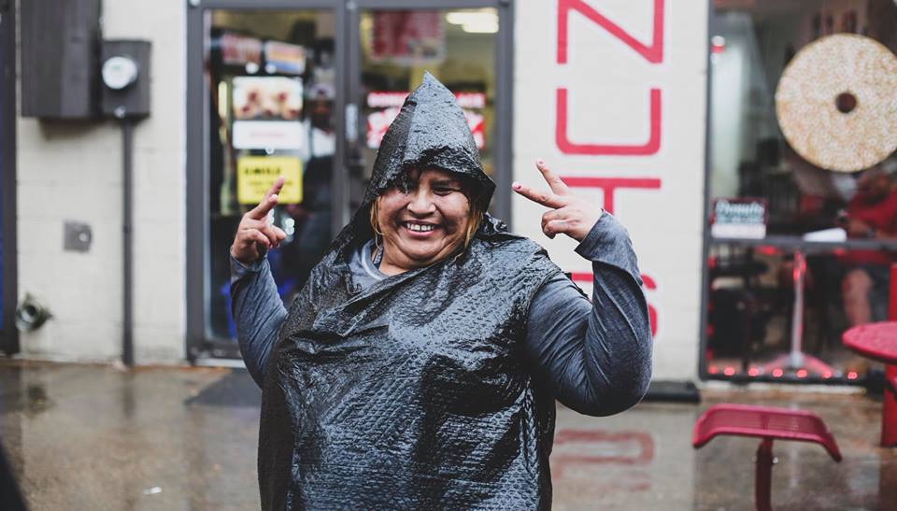
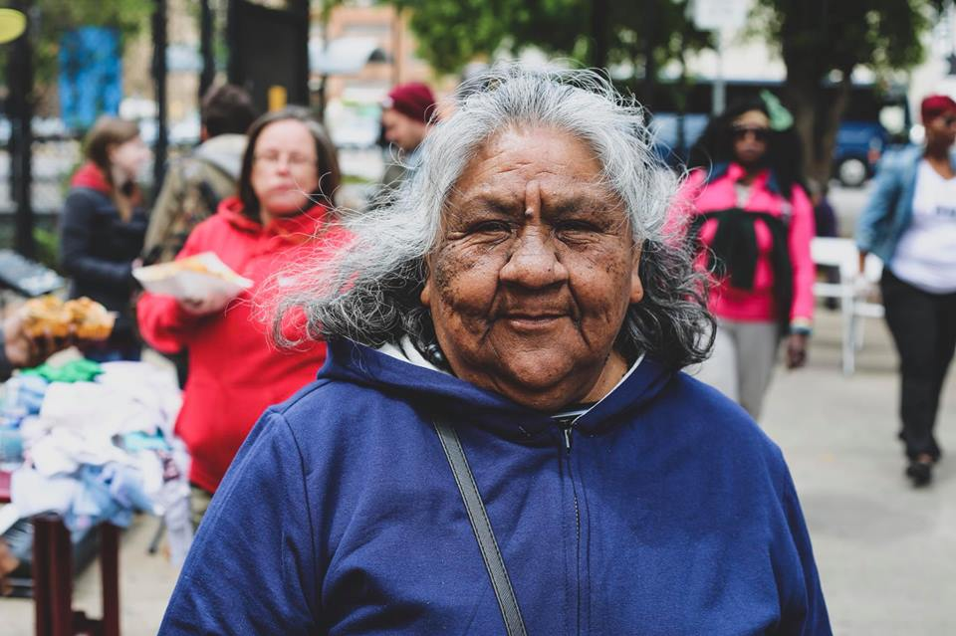

Slide 15
He begins to shift the blame
If you don’t own it you can’t change it
Blaming others is easy but unproductive
Not all failure, is failure
Blame is contagious
Blame never built a great church – What are you for not what you are against
People stop listening
People Stop Caring
People Stop Helping

Slide 16
7:1-3
7 Elisha replied, “Hear the word of the Lord. This is what the Lord says: About this time tomorrow, a seah^{[a]} of the finest flour will sell for a shekel^{[b]} and two seahs^{[c]} of barley for a shekel at the gate of Samaria.”
² The officer on whose arm the king was leaning said to the man of God, “Look, even if the Lord should open the floodgates of the heavens, could this happen?”
“You will see it with your own eyes,” answered Elisha, “but you will not eat any of it!”

Slide 17
“You will see it, but not taste it.
Here we have a call to repent
A call to believe
An invitation to experience

Slide 18
3-5 Who will God use to Save his people?
³ Now there were four men with leprosy^{[d]} at the entrance of the city gate. They said to each other, “Why stay here until we die? ⁴ If we say, ‘We’ll go into the city’—the famine is there, and we will die. And if we stay here, we will die. So let’s go over to the camp of the Arameans and surrender. If they spare us, we live; if they kill us, then we die.”
⁵ At dusk they got up and went to the camp of the Arameans.

Slide 19
7:6-6
When they reached the edge of the camp, no one was there, ⁶ for the Lord had caused the Arameans to hear the sound of chariots and horses and a great army, so that they said to one another, “Look, the king of Israel has hired the Hittite and Egyptian kings to attack us!” ⁷ So they got up and fled in the dusk and abandoned their tents and their horses and donkeys. They left the camp as it was and ran for their lives.
⁸ The men who had leprosy reached the edge of the camp, entered one of the tents and ate and drank. Then they took silver, gold and clothes, and went off and hid them. They returned and entered another tent and took some things from it and hid them also.

Slide 20
7:9-11: Their Realization
⁹ Then they said to each other, “What we’re doing is not right. This is a day of good news and we are keeping it to ourselves. If we wait until daylight, punishment will overtake us. Let’s go at once and report this to the royal palace.”
¹⁰ So they went and called out to the city gatekeepers and told them, “We went into the Aramean camp and no one was there—not a sound of anyone—only tethered horses and donkeys, and the tents left just as they were.” ¹¹ The gatekeepers shouted the news, and it was reported within the palace.

Slide 21
1. Identified the Problem •.
2. Alignment on the Vision•
3. Confirmation on the Mission
4. Focus • Focus says “no” to all things that fall outside strategy.

Slide 22
7:12-17
¹² The king got up in the night and said to his officers, “I will tell you what the Arameans have done to us. They know we are starving; so they have left the camp to hide in the countryside, thinking, ‘They will surely come out, and then we will take them alive and get into the city.’”
¹³ One of his officers answered, “Have some men take five of the horses that are left in the city. Their plight will be like that of all the Israelites left here—yes, they will only be like all these Israelites who are doomed. So let us send them to find out what happened.”
¹⁴ So they selected two chariots with their horses, and the king sent them after the Aramean army. He commanded the drivers, “Go and find out what has happened.”¹⁵ They followed them as far as the Jordan, and they found the whole road strewn with the clothing and equipment the Arameans had thrown away in their headlong flight. So the messengers returned and reported to the king. ¹⁶ Then the people went out and plundered the camp of the Arameans. So a seah of the finest flour sold for a shekel, and two seahs of barley sold for a shekel, as the Lord had said.

Slide 23
Who will be your 2?

Slide 24
7:17-20
¹⁷ Now the king had put the officer on whose arm he leaned in charge of the gate, and the people trampled him in the gateway, and he died, just as the man of God had foretold when the king came down to his house. ¹⁸ It happened as the man of God had said to the king: “About this time tomorrow, a seah of the finest flour will sell for a shekel and two seahs of barley for a shekel at the gate of Samaria.”
¹⁹ The officer had said to the man of God, “Look, even if the Lord should open the floodgates of the heavens, could this happen?” The man of God had replied, “You will see it with your own eyes, but you will not eat any of it!” ²⁰ And that is exactly what happened to him, for the people trampled him in the gateway, and he died.

